Slide 1




Creating Joins

Slide 2

SQL Joins
The need to retrieve data from multiple tables is due to the design of relational
database tables. When designing a table, you do it in a way that avoids repeating data. That’s a good thing because if some data changes (say, a customer address), you don’t have to dive into every place that the address occurs to change it

Slide 3
SQL Joins
A database in a relational database management system uses relations between tables. A relation in relational database terminology is, in actuality, a table. But in the context of relational database modeling, it means the table and how it relates to other tables, using relationships between those tables.

Slide 4
SQL Joins
Inner join: An intersection between two tables where only matching rows are returned.
Outer join: Includes an intersection plus rows in one table, which are not present in both tables.
Cross join: A Cartesian product merging rows from two tables, regardless of any matching values. A Cartesian product joins every row in one table to every other row in the second table, regardless of any matching values.

Slide 5
Creating an Inner Join
An inner join is an intersection between two tables where rows are joined based on one or more matching column values. Inner joins allow you to answer questions like, “Which books does Algodata Infosystems publish and what categories are they in?” You need to retrieve information from the dbo.publishers and dbo.titles tables to answer those questions.

Slide 6
Creating an Inner Join
USE pubs
SELECT publishers.pub_name, titles.title, titles.type
FROM publishers
INNER JOIN titles
ON publishers.pub_id = titles.pub_id
WHERE publishers.pub_name = ‘Algodata Infosystems ’

Slide 7
Creating an Outer Join
An outer join finds rows in one table of a join that are not in the other table — in addition to the intersecting rows from both tables. There is an exception to this rule called a full outer join, which finds the intersection, plus rows in both tables not in the other. A full outer join is not the same as a Cartesian product because any outer join still includes at least the intersection.

Slide 8
Creating an Outer Join
Side is important when you create an outer join. The table whose name comes before the JOIN keyword is the left table. The table whose name comes after the JOIN keyword is the right table. In a left outer join, all values in selected columns in the left table are displayed. If the right table has a corresponding value, it’s displayed too. If there is no corresponding value, a NULL value is displayed in the results.

Slide 9
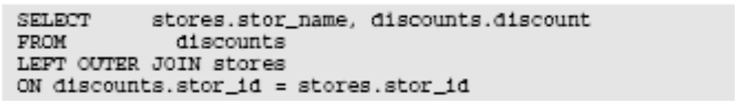
Creating an Outer Join
To show you how outer joins work, I use the stores and discounts tables from the pubs database. “Which stores have each of the specified discount levels?”

Slide 10
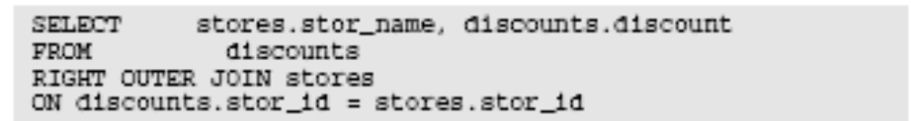
Creating an Outer Join
“What discount, if any, does each store have?” Simply change LEFT to RIGHT and you create a right outer join.

Slide 11
Creating a Cross Join
A cross join creates a Cartesian product or multiplication of all rows in one table, with all rows in another. So, for example, if one table has 10 rows and another 100 rows, a cross-join query produces the product of 10 and 100, which is 1,000 rows. The data from each table is not necessarily related in all query row results.

Slide 12
Creating a Cross Join
As a result, a cross join isn’t something you use often. Cross joins are often used for generating test data — and sometimes for data-warehouse analytics. A cross join generates more rows than are in either table used in the cross join. To create a cross join on the stores and discounts tables, use this syntax:

Slide 13
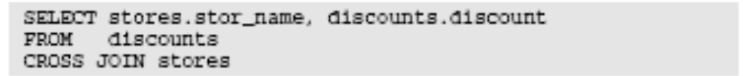
Creating a Cross Join
There are 18 rows returned. Look back at Figure and you see that there are six rows in the stores table and three rows in the discounts table. It is no coincidence that 18 = 3 * 6. A cross join displays every combination of the values in a row in one table with every combination of the value(s) in a row in the other table. This is also known as a Cartesian product.

Slide 14
Creating a Cross Join
You can use a cross join to create large quantities of test data by creating relatively small amounts of data in two tables. The cross join creates all possible combinations of rows from each table. Cross joins can cause serious performance problems and are best avoided.

Slide 15
Using Table Aliases
Take a look at the following SELECT statement. It is basically the same statement as an example used in the previous lesson, but it has been modified to use aliases:
SELECT cust_name, cust_contact
FROM customers AS c, orders AS o, orderitems AS oi
WHERE c.cust_id = o.cust_id
AND oi.order_num = o.order_num
AND prod_id = ‘TNT2’;

Slide 16
Using Different Join Types Self Joins
This query requires that you first find out which vendor creates item DTNTR and then find which
other products are made by that vendor. The following is one way to approach this problem:
SELECT prod_id, prod_name
FROM products
WHERE vend_id = (SELECT vend_id
FROM products
WHERE prod_id = ‘DTNTR’);

Slide 17
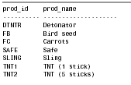
Using Different Join Types Self Joins

Slide 18
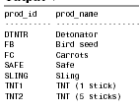
Using Different Join Types Self Joins
Now look at the same query using a join:
Input ▼
SELECT p1.prod_id, p1.prod_name
FROM products AS p1, products AS p2
WHERE p1.vend_id = p2.vend_id
AND p2.prod_id = ‘DTNTR’;

Slide 19
Natural Joins
Whenever tables are joined, at least one column appears in more than one table (the columns being joined). Standard joins (the inner joins you learned about in the previously ) return all data, even multiple occurrences of the same column. A natural join simply eliminates those multiple occurrences so only one of each column is returned.

Slide 20
Natural Joins
A natural join is a join in which you select only columns that are unique. This is typically done using a wildcard (SELECT *) for one table and explicit subsets of the columns for all other tables. The following is an example:
SELECT c.*, o.order_num, o.order_date,
oi.prod_id, oi.quantity, OI.item_price
FROM customers AS c, orders AS o, orderitems AS oi WHERE c.cust_id = o.cust_id AND oi.order_num = o.order_num AND
prod_id = ‘FB’;

Slide 21
Using Joins with Aggregate
Functions
You want to retrieve a list of all customers and the number of orders that each has placed. The following code uses the Count() function to achieve this:
SELECT customers.cust_name,
customers.cust_id,
Count(orders.order_num) AS num_ord
FROM customers INNER JOIN orders
ON customers.cust_id = orders.cust_id
GROUP BY customers.cust_name,
customers.cust_id;

Slide 22

Using Joins with Aggregate
Functions

Slide 23
Using Joins with Aggregate
Functions
This SELECT statement uses INNER JOIN to relate the customers and orders tables to each other. The GROUP BY clause groups the data by customer, and so the function call Count(orders.order_num) counts the number of orders for each customer and returns it as num_ord.

Slide 24
Using Joins with Aggregate
Functions
SELECT customers.cust_name,
customers.cust_id,
Count(orders.order_num) AS num_ord
FROM customers LEFT OUTER JOIN orders
ON customers.cust_id = orders.cust_id
GROUP BY customers.cust_name,
customers.cust_id;

Slide 25

Using Joins with Aggregate
Functions

Slide 26
Using Joins with Aggregate
Functions
This example uses a left outer join to include all customers, even those who have not placed any orders. The results show that customer Mouse House (with no orders) is also included this time.

Slide 27
Using Joins and Join Conditions
Pay careful attention to the type of join being used. More often than not, you’ll want an inner join, but there are often valid uses for outer joins too.
Make sure you use the correct join condition, or you’ll return incorrect data.
Make sure you always provide a join condition, or you’ll end up with the Cartesian product.

Slide 28
Using UNION
A UNION must be composed of two or more SELECT statements, each separated by the keyword UNION. (Therefore, if you were combining four SELECT statements, you would use three UNION keywords.)
Each query in a UNION must contain the same columns, expressions, or aggregate functions, and they must be listed in the same order.

Slide 29
Using UNION
SELECT vend_id, prod_id, prod_price
FROM products
WHERE prod_price <= 5
UNION ALL
SELECT vend_id, prod_id, prod_price
FROM products
WHERE vend_id IN (1001,1002);

Slide 30
Full-Text Searching
Once a database has been created, support for full text must be enabled before any full-text operations can be performed. To enable full-text support, use the sp_fulltext_database stored procedure. This stored procedure updates the currently selected database, so be sure to USE the correct database before issuing this statement:
EXEC sp_fulltext_database ‘enable’;

Slide 31
Full-Text Searching
Server stores full-text data in a catalog (a file
that needs to be created). A single catalog can be used for multiple tables and indexes, so feel free to use an existing catalog if one exists. Alternatively, just create a catalog using CREATE FULLTEXT CATALOG:
CREATE FULLTEXT CATALOG catalog_crashcourse;

Slide 32
Full-Text Searching
Now that a catalog has been created, you can define the actual full-text indexes. Indexes are created using CREATE FULLTEXT INDEX, as seen here:
Input ▼
CREATE FULLTEXT INDEX ON productnotes(note_text)
KEY INDEX pk_productnotes
ON catalog_crashcourse;

Slide 33
Full-Text Searching
This creates a full-text index on table productnotes, indexing the note_text column. The key with which to uniquely identify rows is required, so KEY INDEX is used to provide the name of the table’s primary key, pk_productnotes. Finally, the ON clause specifies the catalog to be used to store full-text data, and here the just created catalog is used.

Slide 34
Searching Using FREETEXT
FREETEXT is used to search for rows that contain words or phrases that might mean the same as (or are similar to) a specified phrase.
Let’s look at an example. The following is a simple LIKE wildcard SELECT:
Input ▼
SELECT note_id, note_text
FROM productnotes
WHERE note_text LIKE ‘%rabbit food%’;

Slide 35
Searching Using FREETEXT
This statement looks for the phrase rabbit food within column note_text. No rows are returned because that phrase does not appear in any rows. Now the same search using FREETEXT full-text searching:
Input ▼
SELECT note_id, note_text
FROM productnotes
WHERE FREETEXT(note_text, ‘rabbit food’);

Slide 36

Searching Using FREETEXT

Slide 37
Searching Using CONTAINS
CONTAINS is used to search for rows that contain words, phrases, partial phrases, words with the same stem, proximity searches, synonyms (using
a thesaurus lookup), and more.
Let’s start with a simple example:
Input ▼
SELECT note_id, note_text
FROM productnotes
WHERE CONTAINS(note_text, ‘handsaw’);

Slide 38

Searching Using CONTAINS
CONTAINS also supports the use of wildcards, as seen here:
Input ▼
SELECT note_id, note_text FROM productnotes
WHERE CONTAINS(note_text, ‘“anvil*”’);

